Slide 1
SUBMISSION BY THE TB ACCOUNTABILITY CONSORTIUM
TO THE SELECT COMMITTEE ON APPROPRIATIONS ON THE DIVISION OF REVENUE BILL
SUSTAINABILITY AMID A CHANGING LANDSCAPE

Slide 2
PUBLICLY FUNDED HEALTHCARE IS DISTRESSED
Allocations to health have decreased in real terms over the last decade despite increases in the cost of health and various pressures on the system. These costs include:
  Above-inflation increases for healthcare workers crowding out the ability to employ new staff
  rising medical inflation particular in respect of medicines and equipment
  Poor financial planning and management
  Weak supply chain management systems that fail to mitigate the impact of procurement corruption
Chronic underfunding as noted by the Minister has contributed to provincial governments carrying over budget shortfalls in excess of R22 billion
The withdrawal of overseas development assistance (USAID) resulted in the loss of 15 000 front line staff and further 9000 technical staff including staff at the successful CCMD Programme
We welcome the budget proposals with above-inflation increases to the health component of the provincial equitable share as well as the increases in allocations to the NDOH
We are disappointed that the allocations to the District Health Programme conditional grant have not included a R6-R8 billion contribution to fill the gap created by the withdrawn USAID investments

Slide 3
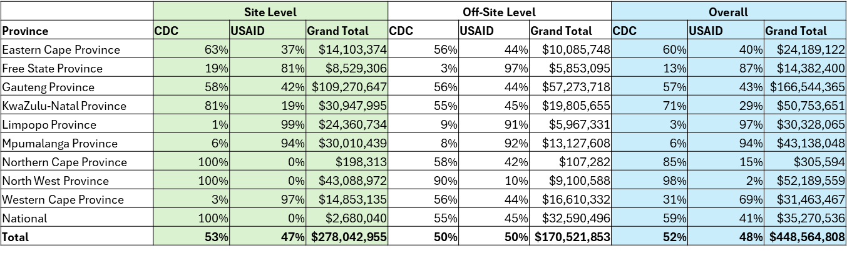
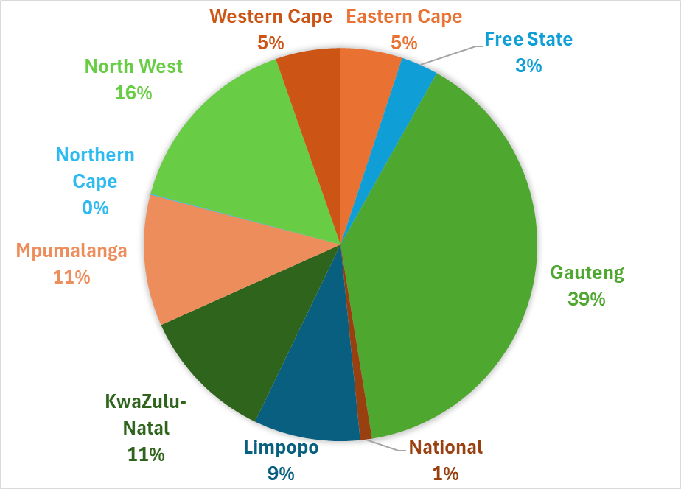
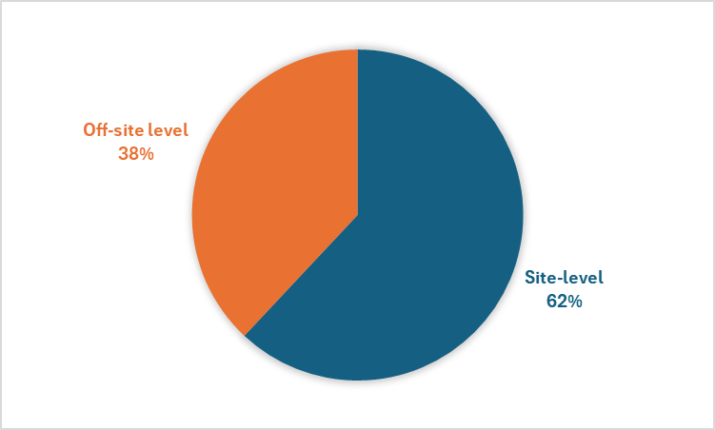
BROAD FUNDING IMPACT
Total budget allocation - USD488m – 52% CDC/48% USAID
Rand terms – site level activities = R5b - an additional 8% contribution to the total RSA Health Budget
62% allocated to on-site level activities
Gauteng receives 39% of the onsite allocation
High-burden TB Provinces receive the following allocation:
  WC – $14.8m or 5%
  KZN - $11m or 11%
  EC - $14.1m or 5%
Split between on and off-site spend

Slide 4
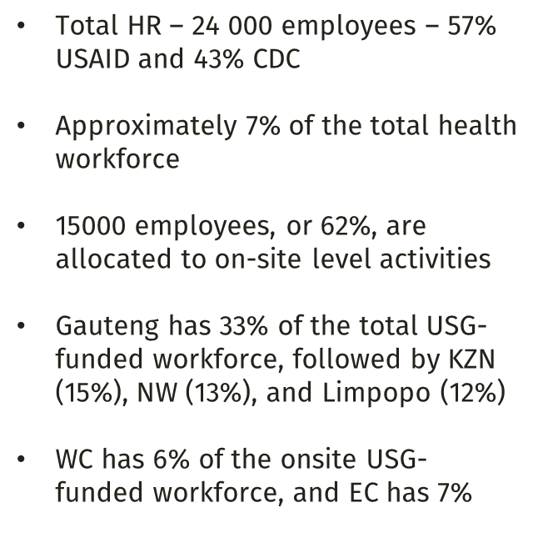
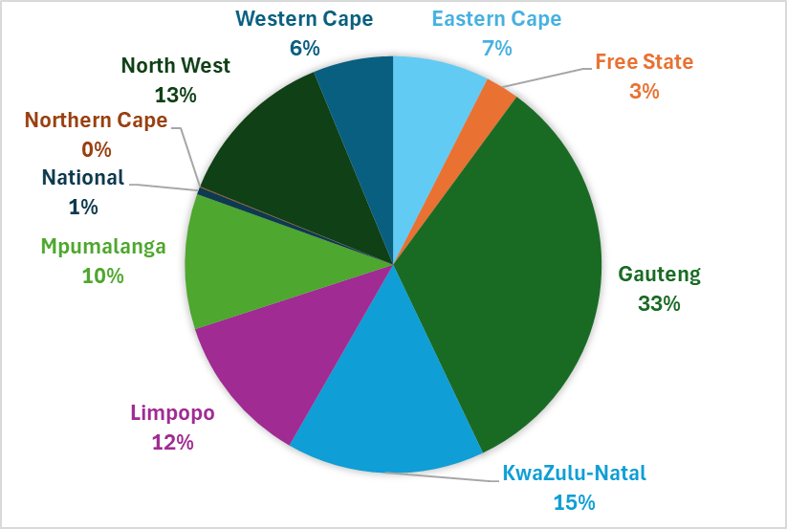

BROAD HR IMPACT

Slide 5
THE STATE OF TB IN SOUTH AFRICA
TB remains the leading cause of death in South Africa with estimated 56 000 deaths annually.
An estimated 270 000 people contracted TB in South Africa in 2023
It is encouraging to note that since 2015 the annual death rate has declined significantly largely as result of the sharp rise in people living with HIV initiated into life saving Anti-Retroviral Treatment (ART).
HIV/AIDS remains the significant contributor to TB mortality with estimated 57% of deaths diagnosed in hospital, which is often too late
South Africa has 10 years to meet the WHO’s End TB targets
  Incidence rates have reached the 2025 End TB Strategy targets, SA still has to increase the treatment coverage rate by 13% and reducing TB deaths by 46,000 per year.
  There are about 65 000 people who are termed “missing”. They know they have TB but are not on treatment.

Slide 6
SA’S AMBITIOUS END TB CAMPAIGN
Over the last 10 years the national TB Programme has halved TB incidence, increased TB case finding and reduced deaths.
But this is not enough
South Africa’s TB programme has launched the End TB Campaign which aims to test 5 million people in 2025/26.
This will involve diagnosing 250,000 new cases. This is expected to lead to a projected 29% reduction in TB incidence and a 41% reduction in mortality by 2035.
To achieve our End TB targets we need accelerate case finding and scale up testing as recommended in the End TB campaign.

Slide 7
THERE ARE RISKS TO IMPLEMENT THE CAMPAIGN
  Provinces are responsible for the implementation of National Health Policies which include the implementation of National TB programme strategy
  To perform this function provinces are funded through the provincial equitable share based on a revised health component formula that includes health care utilisation. Excess mortality as a proxy for unmet health need, multi deprivation indexes as proxy for the social determinants of health which include poverty, education and income
  While we welcome the R28 billion addition to the equitable share, provincial resource allocation processes are shaped by historical spending with limited room for fully implementing national policies.
  While the additional allocations will fund sector wage increases , allowance for employment of 800 health care professionals . The concern remains that not enough money will be allocated to meet the funding needs of the end TB campaign
  The reduction in overseas development assistance will further weaken district health capacity with the loss of 15 000 front line health care workers which will impact the effective implementation of the END TB Strategy

Slide 8

RECOMENDATIONS
To mitigate the impact of the USAID funding withdrawal on HIV and TB services we recommend the expansion of the District Health Programme Conditional Grant. This includes increase the funding of the TB component to ensure TB services are adequately funded
This will allow for improved financial and programmatic accountability as well as facilitating improved coordination of the response to HIV/AIDS TB and STI
Improving the effectiveness of the funding and the strategic priority that the governance of the grant be included in the national health council deliberations through the establishment of special committee that is co chaired by the National AIDS Councils
https://tbac.org.za/publications/

