Slide 1
SUBMISSION BY THE TB ACCOUNTABILITY CONSORTIUM
TO THE SELECT COMMITTEE ON APPROPRIATIONS
RESILIENCE OF THE TB RECOVERY PLAN

Slide 2
INTRODUCTION AND OBJECTIVE OF TBAC
TBAC’s purpose is the promotion of accountability and transparency in the allocation, distribution, and disbursement at a national and provincial level. Taking on the role of increasing, connecting and communicating existing and emerging efforts contributing to improved TB programme performance.
Support implementation of TB strategies (as reflected in TB Recovery Plan, NTP Strategic Plan and NSP)
  To monitor and input on budget allocations and processes linked to the TB programme
  To track provincial TB programme implementation
  To strengthening accountability within district level processes

Slide 3
TB RECOVERY PLAN OBJECTIVES
Improved case finding through the Implementation of targeted universal TB testing
Strengthening linkage to care for people diagnosed with TB
Strengthen retention in care of people diagnosed with TB
Strengthen TB prevention strategies

Slide 4
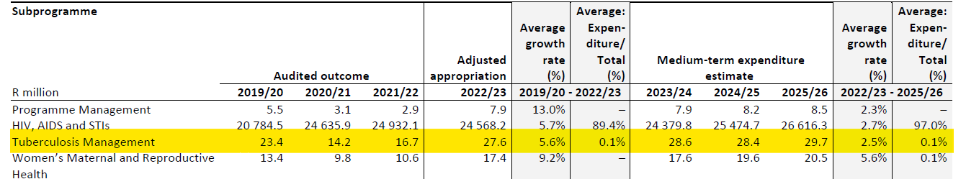
TB PROGRAMME MANAGEMENT
The National TB program is responsible for the coordination of the implementation of the national TB program is located within Programme 3 of the National Expenditure estimates
Over the medium term, program budget remains stagnant with a 0,01 percent increase this is despite the required coordination of the implementation of the TB recovery and the launch of the new NTP expected in the coming weeks.
Areas of underperformance in governance within process efficiency and effectiveness, with long approval turnaround times, poor National TB Programme manager empowerment and no data available on absorption of funds from all sources *
*Stop TB Partnership, United States Agency International Development. Governance of TB programs [Internet]. Geneva: Stop TB Partnership; 2021

Slide 5
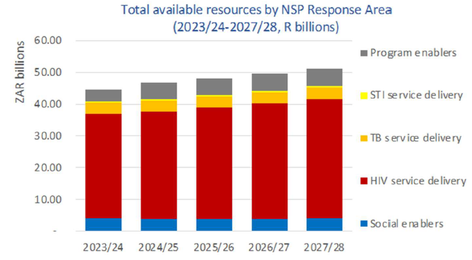
DISTRICT HEALTH PROGRAMME GRANT
District Health Programme Grant now named HIV, TB, malaria and community outreach grant
  Strategic goal of implementation of NSP
  Grouping of HIV/AIDS, TB, community outreach, malaria, HPV and COVID-19 components further complicate budget planning and expenditure tracking
There is a cut to the grant in the current financial year
  Grant allocation of R84.3 billion
  Lack of transparency in prioritization of provincial provision of TB Recovery Plan
  NSP provisions echo similar sentiments of availability of resourcing
Source data: SANAC NSP Costing 2023-2028

Slide 6
Health component makes up 27 % of the equitable share
TB services primarily funded through the equitable share
The largest cost is the cost of employment and no consideration is given for a public sector wage increase
  The transfers to provinces decline in 2023/4 before rising by an average of 2 percent in the outer years after adjustment for the implementation of Public Sector wage increases resulting in the reduction in funding *
The TB recovery plan necessitates a sharp increase in testing , increased enrolment into care which will require additional spending on testing and medicines.
Amidst uncertainty on future funding flows, it is essential that parliament considers how existing publicly funded health care capacity is optimized and prioritizes those with the greatest need.
*Source data: National Treasury, Stats SA

Slide 7
RECOMMENDATIONS
Section 27 Right to health
  Equitable financial mechanisms, design and implementation of programmes
Chapter 1 of the National Health Act compels the provision of primary health care and eligibility for free public health services
  Transitory plan requires transitory fiscal intervention
Parliament has a responsibility that division of revenue and individual budget votes prioritise these services.

Slide 8
RECOMMENDATIONS
A joint committee to be set up temporarily to review and interrogate provincial departments’ resource allocations decisions for 2023/24/25. Safeguarding strategies are in place to ensure that priority health services like TB and its Recovery Plan are protected
Without explicit protection and prioritisation of primary healthcare could result in increased avoidable deaths
Good governance requires good data. Continued surveillance of TB data in two separate structures will maintain low linkage to care and completion in the TB cascade
  Permit comparison of NICD data with facility level data, effective assessment of those receiving treatment

